Slide 1
Carl Malmgrens Man cave
By Middle age woman

Slide 2
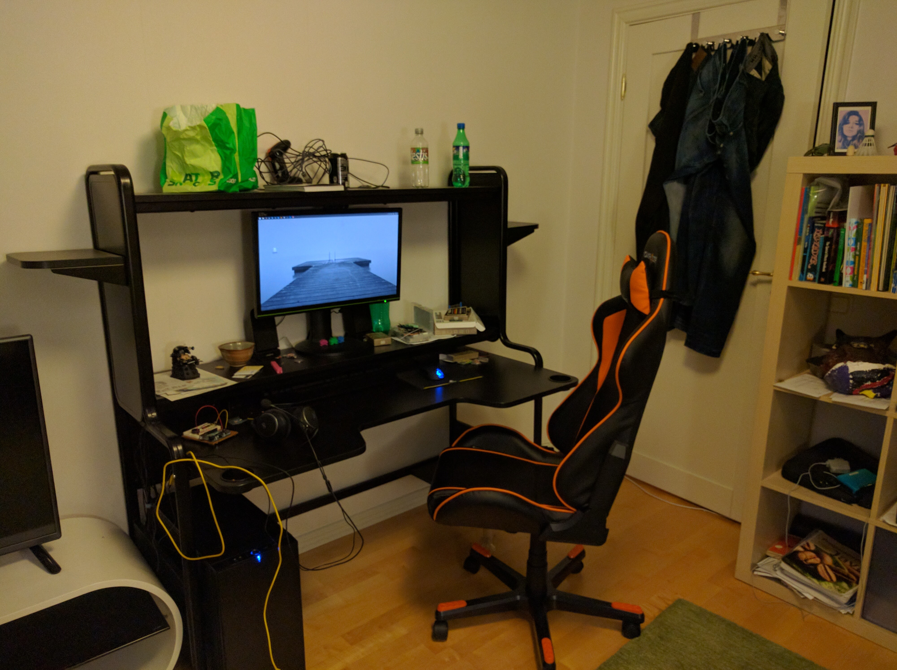
Workspace

Slide 3
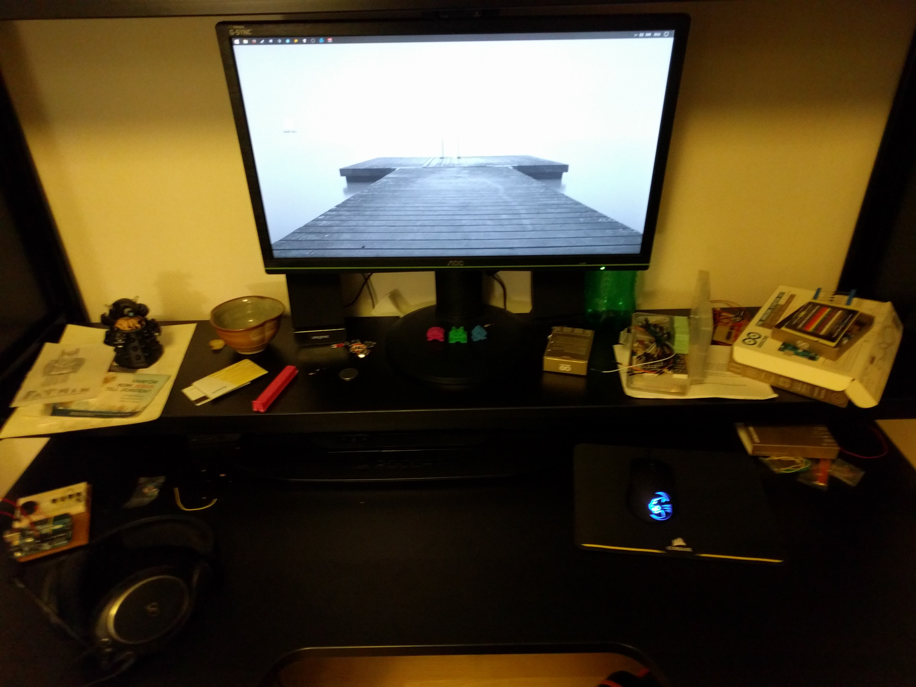

Slide 4


